Slide 1
Development and Characterization of a Foamy Virus-Based Oncolytic Replicating Retroviral Vector
International Oncolytic Virus Conference
November 6th, 2021
Karol Budzik, Ph.D.
Laboratory of Dr. Stephen Russell, M.D., Ph.D.
Department of Molecular Medicine, Mayo Clinic

Slide 2
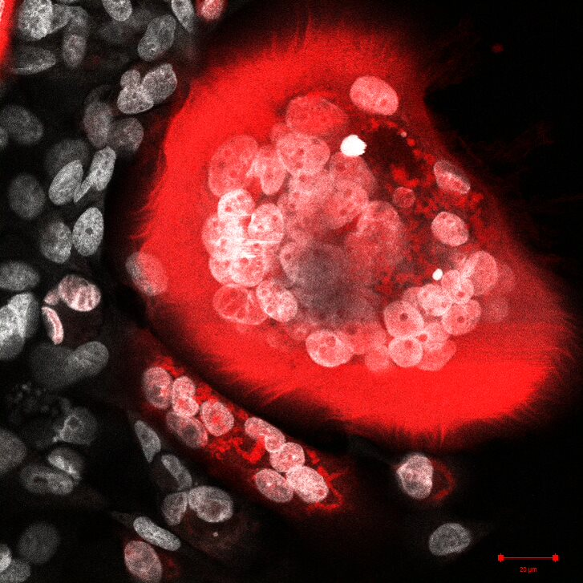
Foamy Viruses (FVs)
Classification:
  Family: Retroviridae,
  Subfamily: Spumaretrovirinae,
  Genus: Spumavirus
Broad tissue tropism and host range
Heparan Sulfate is an attachment factor
Lead to rapid syncytium formation and vacuolization upon infection

Slide 3


Advantages for using FVs in cancer therapy
Simian Foamy Virus
Murine Leukemia Virus
Infects slowly dividing cells
Lack of pathogenicity
Favorable integration profile
Insulator sequence in the genome
Cytopathic effect in vitro

Slide 4
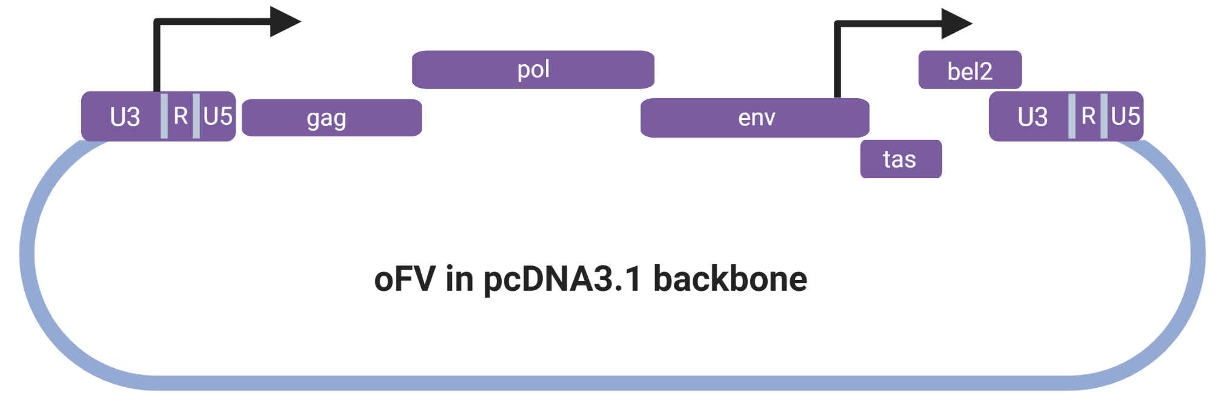
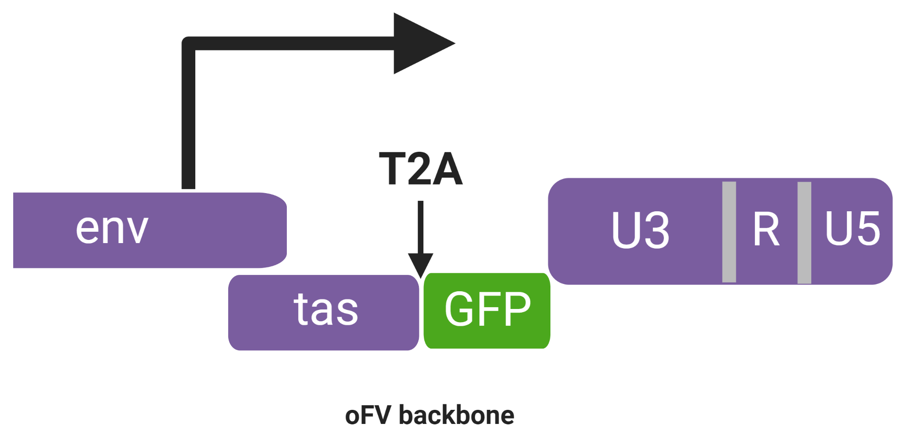
Generation of the oncolytic Foamy Virus (oFV) infectious clone
Tas – transactivator protein
Bet – counteracts APOBEC3G restriction
Transgene placed in bel2
Expression of Tas, Bet and the transgene driven by an internal promoter

Slide 5
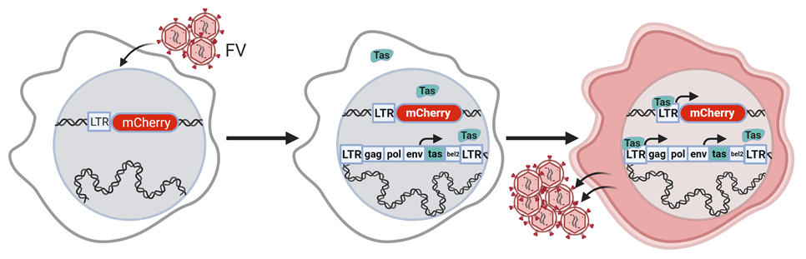
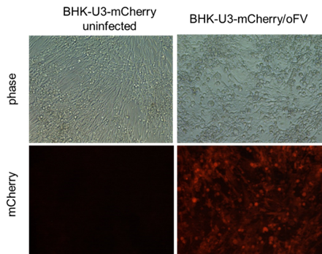
Transactivation by Tas can be utilized for non-invasive monitoring of oFV replication
Subcutaneous U251-U3-mCherry-U3-Fluc tumors
Budzik KM, Nace RA, Ikeda Y, Russell SJ. Oncolytic Foamy Virus - generation and properties of a nonpathogenic replicating retroviral vector system that targets chronically proliferating cancer cells. J Virol. 2021 Mar 10:JVI.00015-21. doi: 10.1128/JVI.00015-21.

Slide 6
oFV replicates slowly, transgene insertion attenuates the oFV vector
MOI=0.01
MOI=3
Budzik KM, Nace RA, Ikeda Y, Russell SJ. Oncolytic Foamy Virus - generation and properties of a nonpathogenic replicating retroviral vector system that targets chronically proliferating cancer cells. J Virol. 2021 Mar 10:JVI.00015-21. doi: 10.1128/JVI.00015-21.

Slide 7
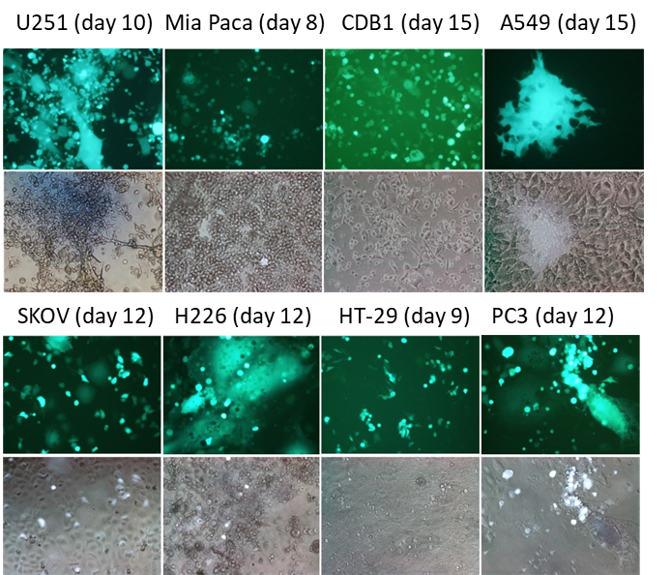
oFV and oFV-GFP induce oncolysis and have a broad cancer tropism
Budzik KM, Nace RA, Ikeda Y, Russell SJ. Oncolytic Foamy Virus - generation and properties of a nonpathogenic replicating retroviral vector system that targets chronically proliferating cancer cells. J Virol. 2021 Mar 10:JVI.00015-21. doi: 10.1128/JVI.00015-21.

Slide 8
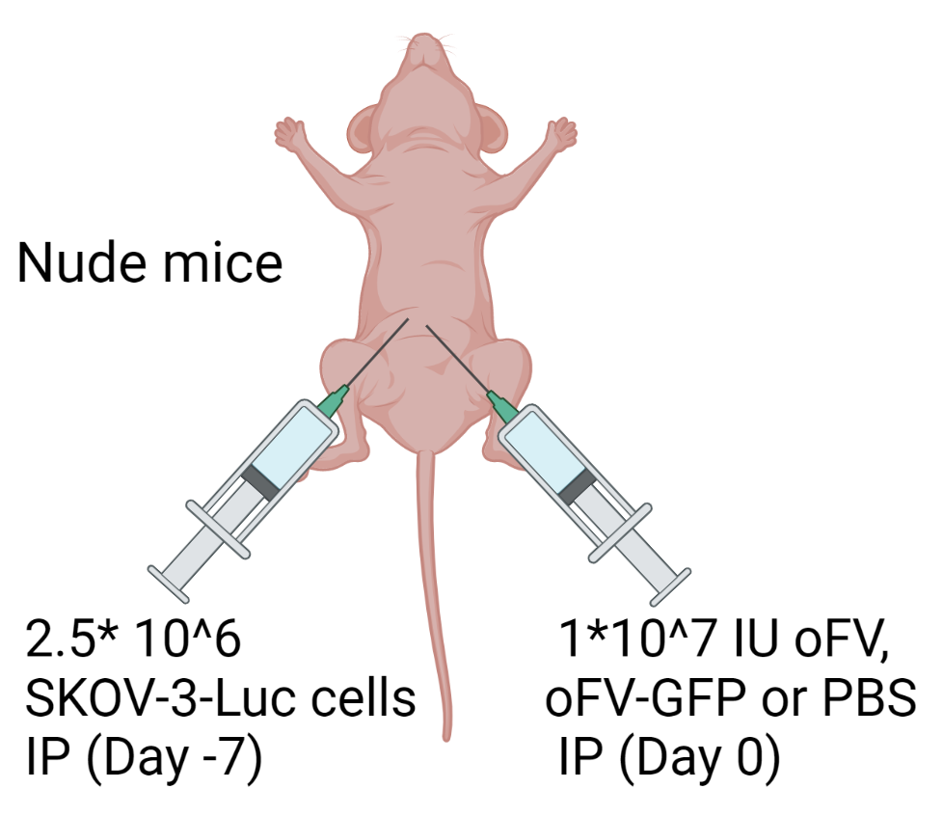
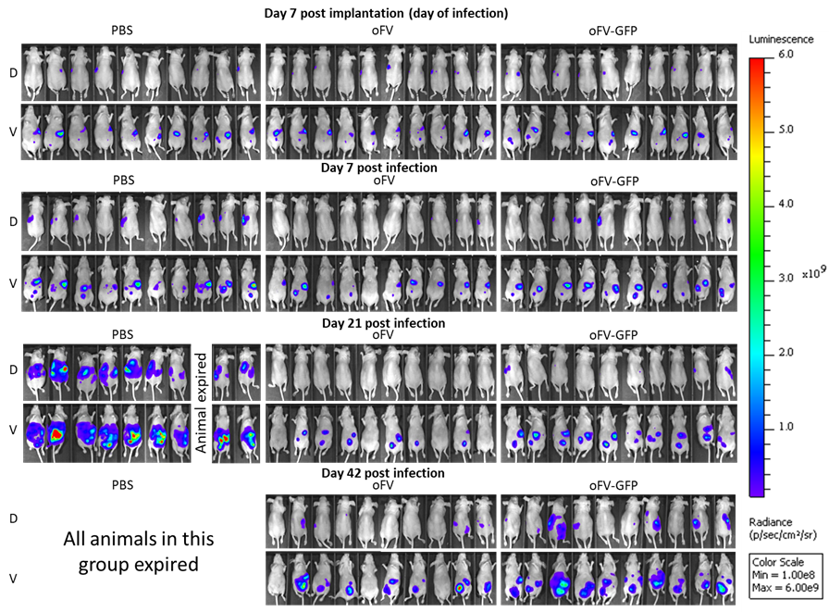
oFV and oFV-GFP have an oncolytic activity in vivo in a xenograft, orthotopic model of intraperitoneal ovarian cancer metastases
* - p<0.0001
Budzik KM, Nace RA, Ikeda Y, Russell SJ. Oncolytic Foamy Virus - generation and properties of a nonpathogenic replicating retroviral vector system that targets chronically proliferating cancer cells. J Virol. 2021 Mar 10:JVI.00015-21. doi: 10.1128/JVI.00015-21.

Slide 9
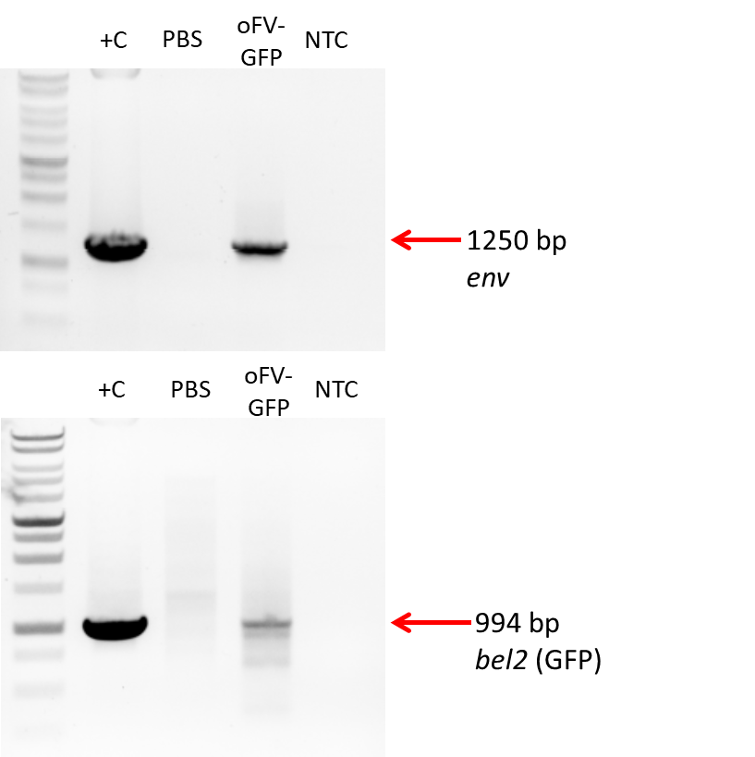
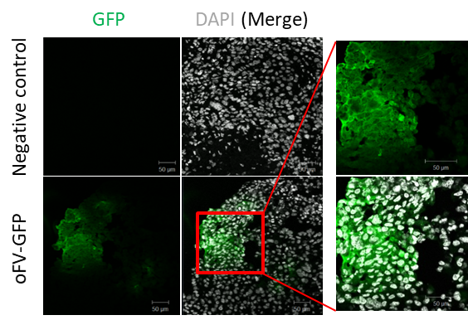
Infection with oFV-GFP leads to intratumoral genome integration and transgene expression
Tumors were explanted, total DNA isolated and analyzed by PCR to detect oFV provirus and transgene
Tumors were snap-frozen, sectioned and stained for GFP to detect transgene expression in the tumors
Budzik KM, Nace RA, Ikeda Y, Russell SJ. Oncolytic Foamy Virus - generation and properties of a nonpathogenic replicating retroviral vector system that targets chronically proliferating cancer cells. J Virol. 2021 Mar 10:JVI.00015-21. doi: 10.1128/JVI.00015-21.

Slide 10
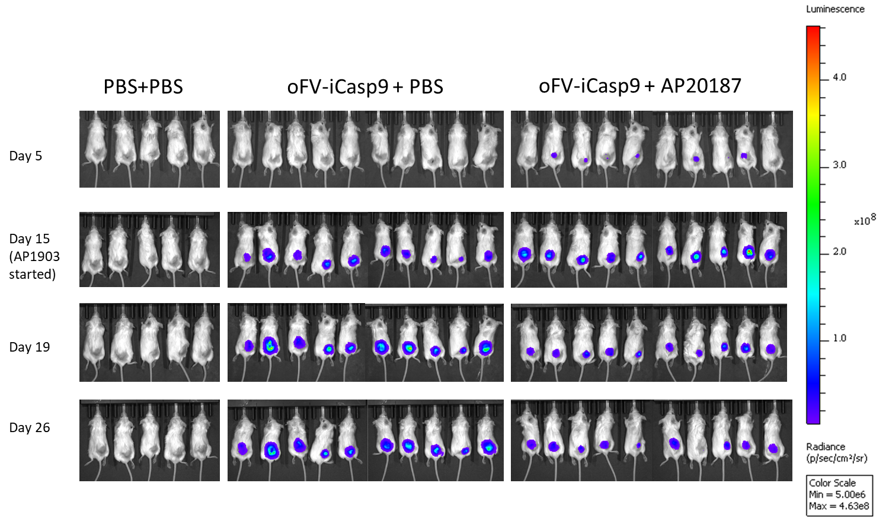
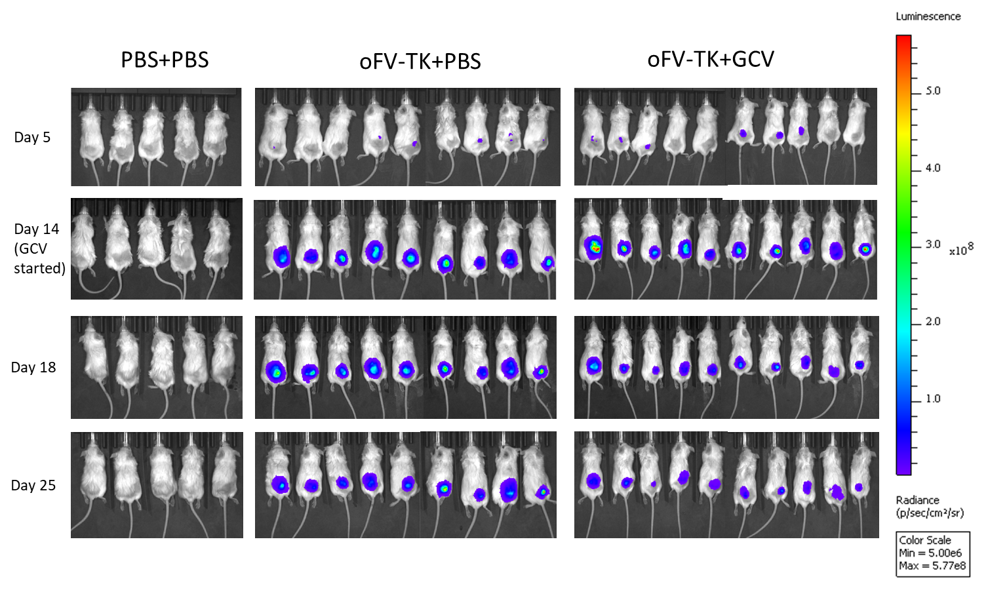
Infection with oFV-TK/oFV-iCasp9 and GCV/AP20187 treatment leads to a decrease in luminescence in indicator U251-U3-mCherry-U3-Luc tumors
CB17 SCID mice, 5*10⁶ U251-U3-mCherry-U3-Luc cells SC
2*10⁶ IU oFV-TK or oFV-iCasp9 or PBS IT, 5x doses
14 dpi GCV (50 mg/kg for 4 weeks) or AP20187 (5 mg/kg for 4 days) IP

Slide 11
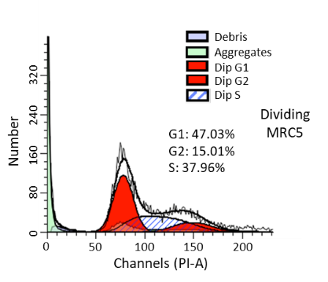
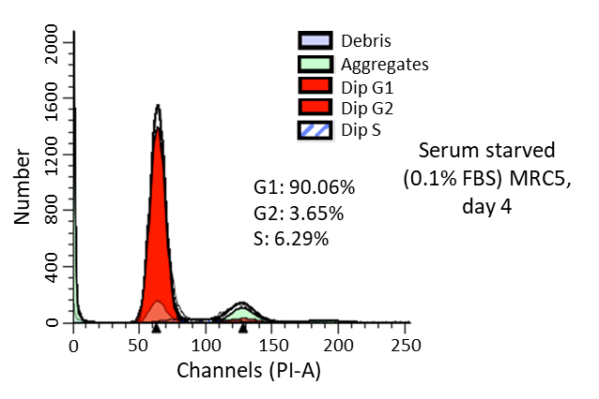
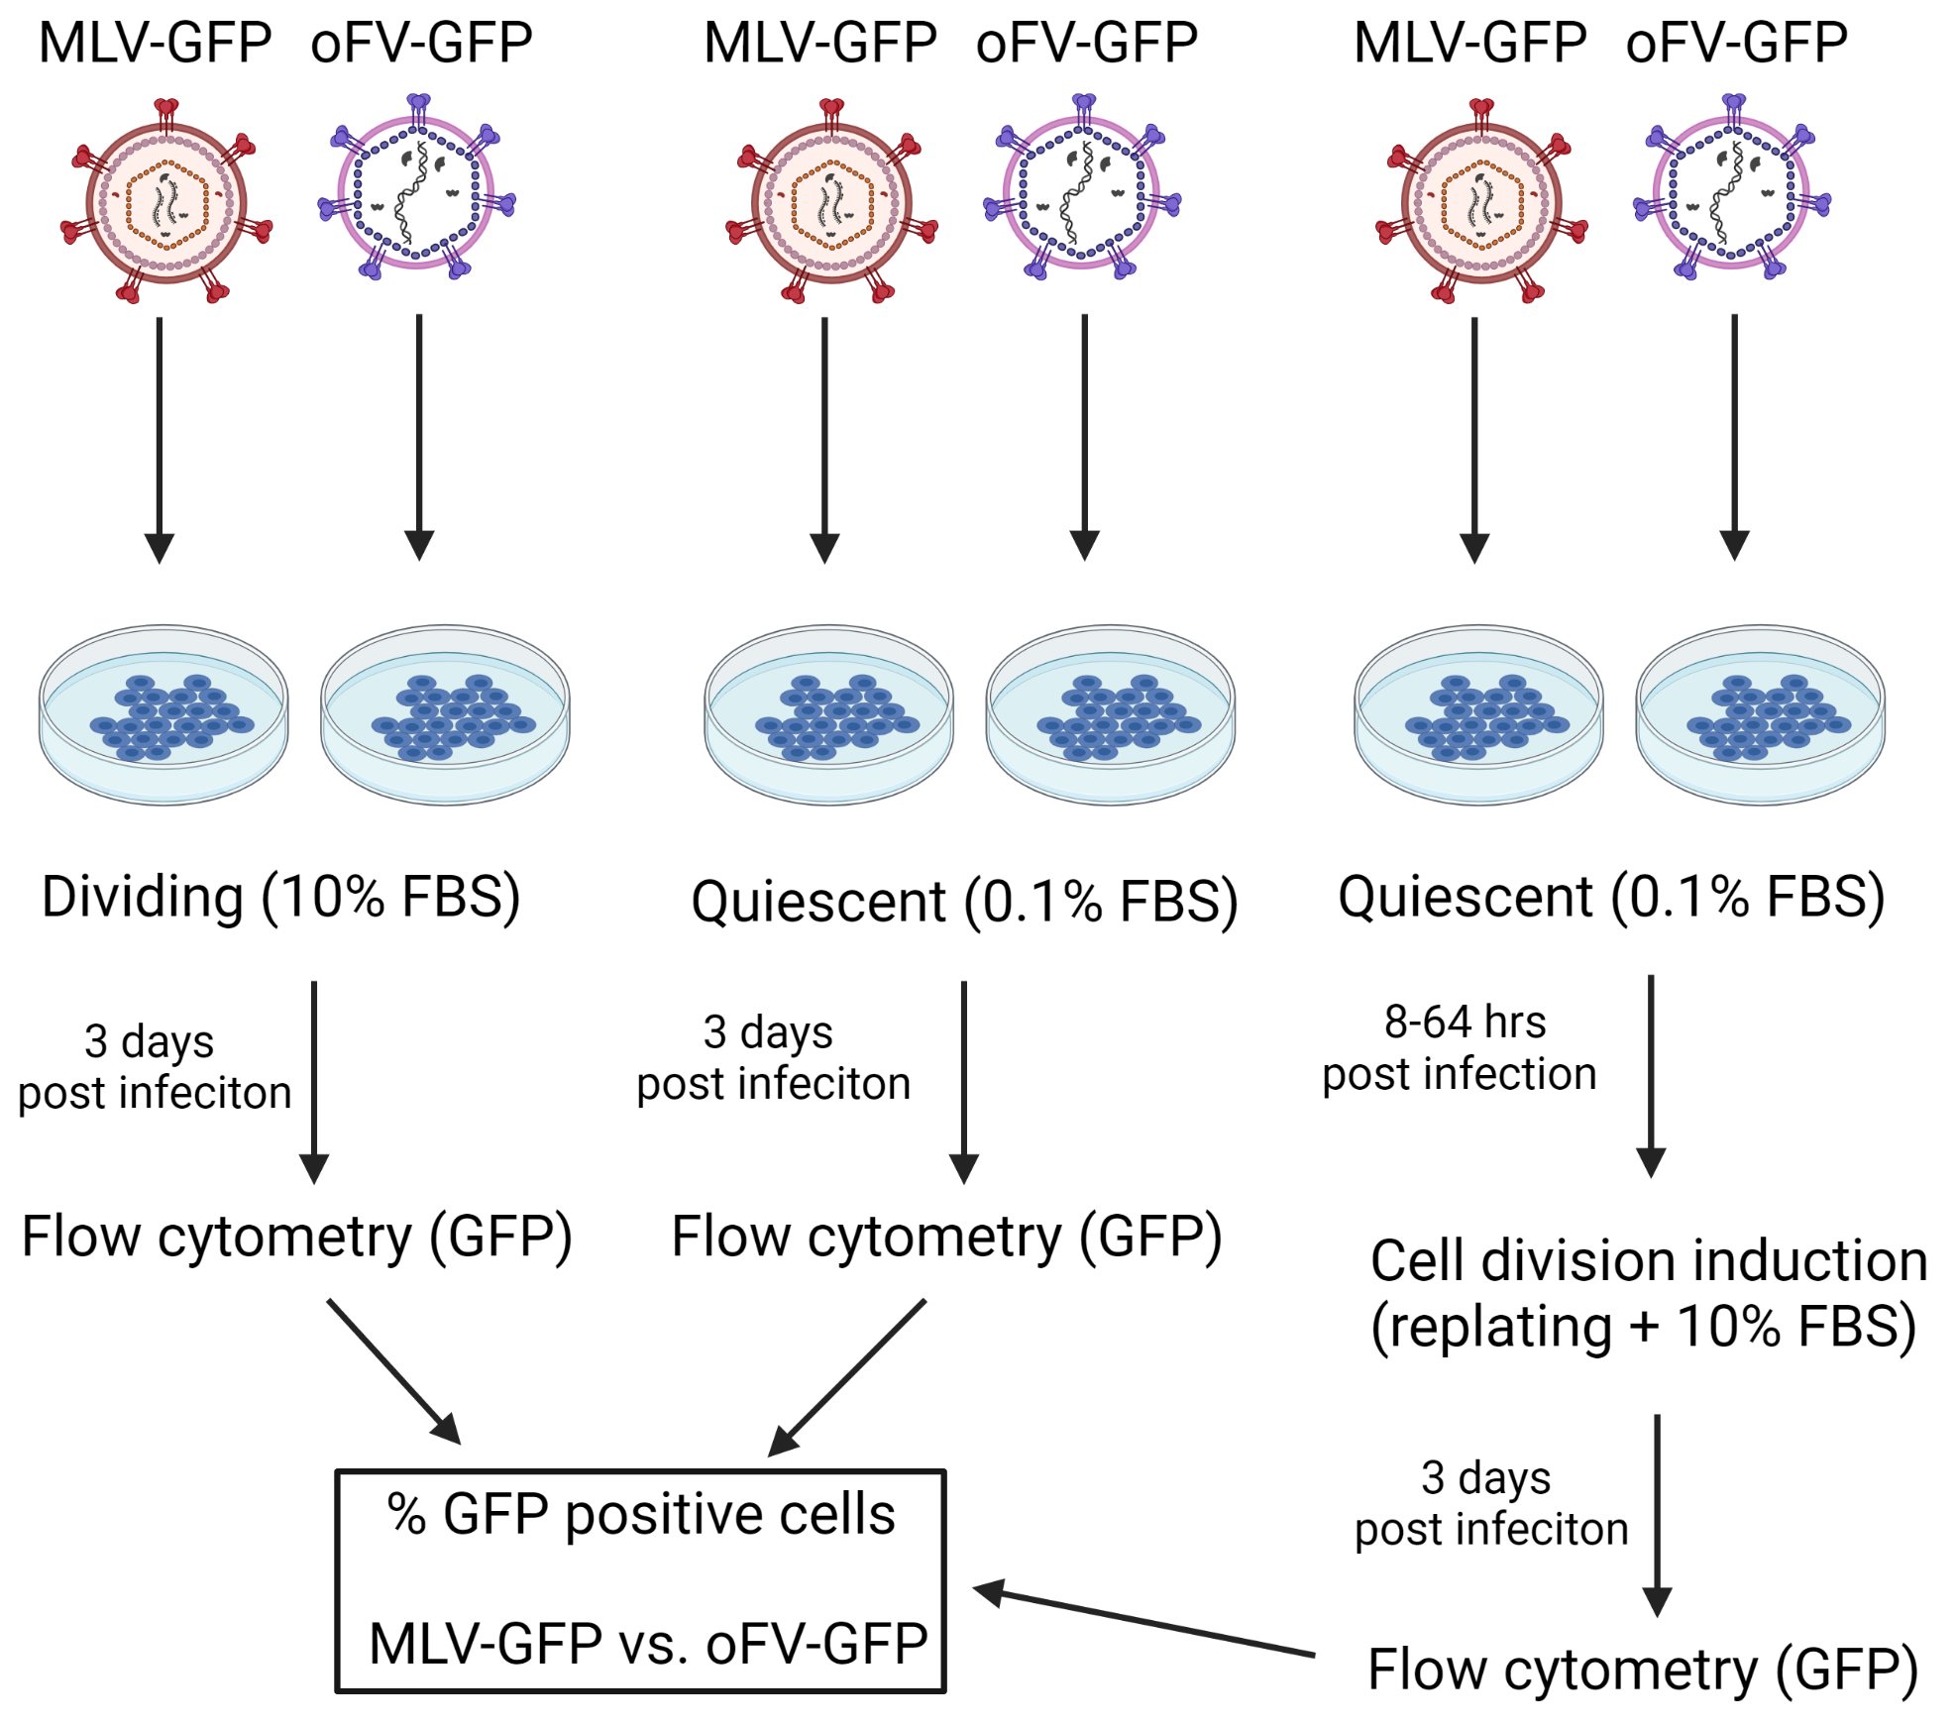
oFV-GFP spreads in slowly dividing cancer cells faster than MLV-GFP and, unlike MLV-GFP, can latently persist in quiescent cells
Budzik KM, Nace RA, Ikeda Y, Russell SJ. Oncolytic Foamy Virus - generation and properties of a nonpathogenic replicating retroviral vector system that targets chronically proliferating cancer cells. J Virol. 2021 Mar 10:JVI.00015-21. doi: 10.1128/JVI.00015-21.

Slide 12
Conclusions and future directions
oFV is a new oncolytic virus platform with a unique ability to target slowly dividing cells - a hallmark of human tumors
oFV shows promise as a tool for intratumoral transgene delivery
Further optimization of the system is required
A collaboration with Dr. Richard Vile (Mayo Clinic) has been established to investigate using oFV for intratumoral transgene delivery to enable CAR T cell therapy in solid tumors

Slide 13
Acknowledgements
Russell Laboratory
  Stephen Russell
  Linh Pham
  Becci Nace
  Anna DeVries
  Miguel Alia-Muñoz
  Elizabeth C. Eckert
  Eugene Bah
  Velia M. Penza
  Justin Maroun
  Susie Concillio
  Haifei Jiang
  Shruthi Naik
  Nanda Packiriswamy
  Talia Ferndandez Carrasco
Schulze Laboratory
  Autumn Schulze
  Yogesh Suryawanshi
  Caitessa Venables
Peng Laboratory
  Kah Whye Peng
  Beth Brunton
  Lianwen Zhang
Toxicology Core
Vile laboratory
Funding:
  Mayo Clinic
  Vyriad
  NIH training grant T32 AI132165
Ikeda Laboratory
  Yasuhiro Ikeda
  Jason Tonne
  Claire Schreiber
  Brian Lu
  Yaxi Zhu
  Salma Morsy
Thesis Committee
  Stephen Russell
  Yasuhiro Ikeda
  Richard Vile
  Kah Whye Peng
  Roberto Cattaneo

Slide 14
Thank you for your attention!

