Slide 1
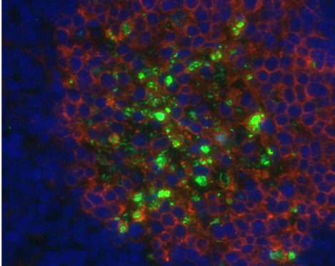
Clinical Activity of Systemic
VSV-IFNβ-NIS
Oncolytic Virotherapy in Patients with
Relapsed Refractory
Hematologic
Malignancies
Joselle Cook MBBS
Division of Hematology
Mayo Clinic, Rochester, MN
IOVC 2021
Nov 5th, 2021
Notes:
I’d like to thank the organizers of IOVC for inviting me to be a part of their conference. It really is such an honor for me this work, which is essentially the culmination of years of hard work, genius and collaboration from our group in the Lab and the Hematology Division at Mayo Clinic. And so today I will be discussing the results of VSV IFNbeta NIS in patients with RR Heme malignancies

Slide 2
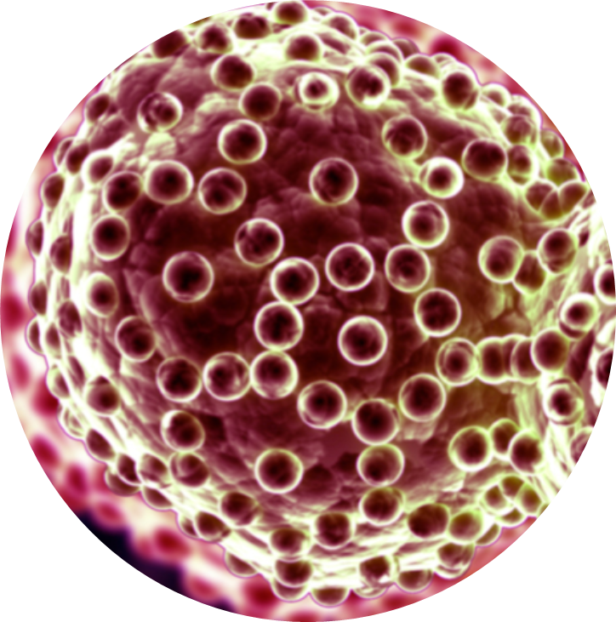


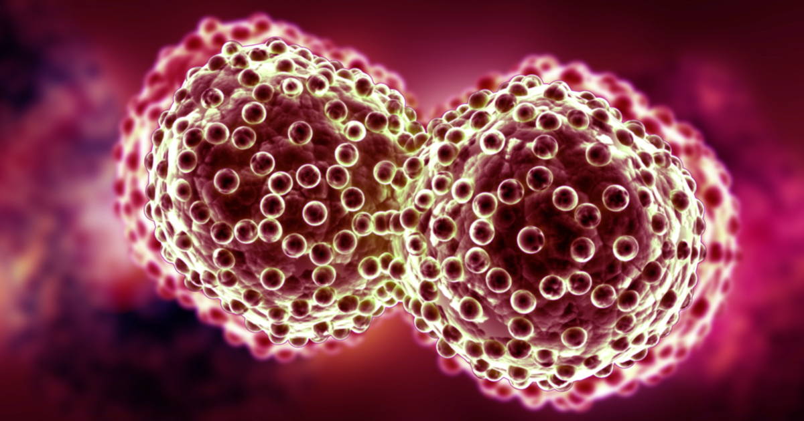

Oncolytic virotherapy:
An Immune modulating cancer strategy
Virus extravasates, seeds tumor
Oncolysis, exposure of tumor antigen
Innate immune response &
Tumor specific T-cell boosting
Infectious foci expand, coalesce
Long term antitumor immunity
Tumor cells
Notes:
This audience is no stranger to the concept and mechanism of oncolytic viruses. This novel therapeutic employs 2 phases- An initial phase on viral infection, replication and production of viral progeny while at the same time inducing tumor cell death, exposure of previously concealed tumor antigen and recruitment of the innate and adaptive arms of the immune system. All in all, the end game is the sensitization of the patient’s immune system to tumor antigen to ultimately produce long term antitumor response

Slide 3
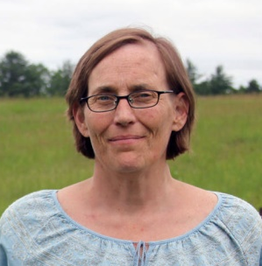
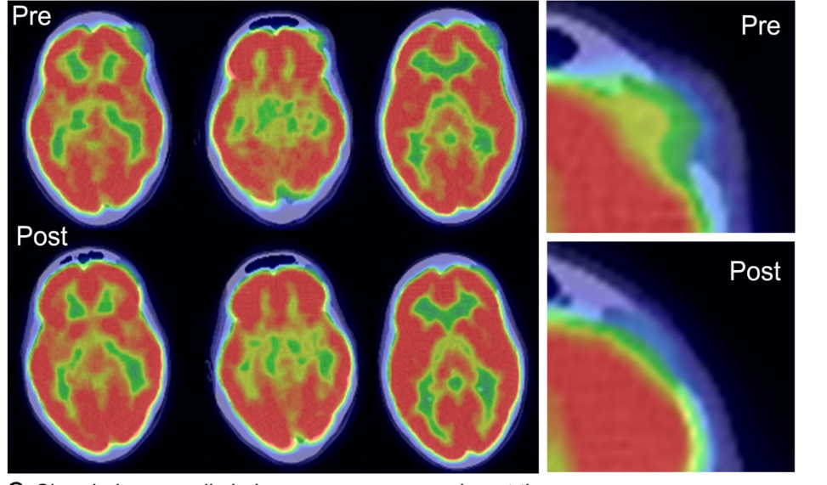
Systemic Delivery of Oncolytic viruses is feasible
Durable cancer remission after Intravenous MV-NIS
Medical history
  Skeletal plasmacytomas (CT)
Relapsing disease with multiple plasmacytomas and diffuse bone marrow involvement
Refractory to all available therapies (including 2 stem cell transplants)
Treatment and outcome
Single infusion of MV-NIS (1e11)
8 year (ongoing) durable CR at all disease sites
  Resolution (PET/CT)
Lessons learned
Antitumor activity was apparent only at DL7 (1e11) and only in patients with undetectable antimeasles antibodies
But >95% of adults are measles immune
Russell et al. Mayo Clinic Proceedings, 2014
Dispenzieri Leukemia 2017
Slide courtesy Dr SJR and Dr KWP
Notes:
Systemic oncolytic viruses have seen remarkable success in hematologic malignancies in the past
This is a patient with relapsed refractory myeloma, multiple plasmacytomas who had a PHENOMENAL received MS-NIS 8 years ago as a single infusion, and since then has remained off of all systemic therapy and remains in a complete remission 8 years after the fact
However, there is a caveat. Most of the population is immune to measles, due to prior vaccination, and so broader application of the viral platform is limited by the seroprevalence of MS antibodies.

Slide 4
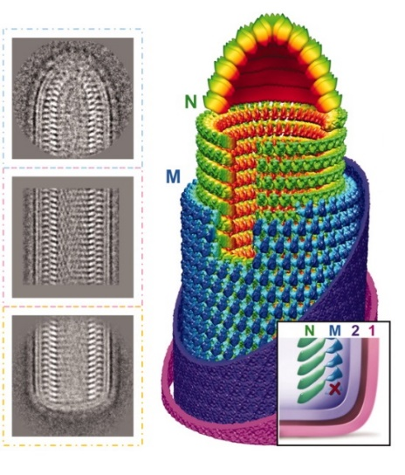
Vesicular Stomatitis Virus
Optimal properties for intravenous therapy
IFNβ
Serves an index of viral proliferation
Enhances host antitumor immunity
Safety
No Human-to-Human transmission
N
P
M
IFNβ
G
NIS
L
Widely studied anticancer activity
Numerous labs, many mouse tumors
Potency
Systemic delivery
Low seroprevalence
Cancer patients lack VSV antibodies
NIS
Reporter gene to enable monitoring of viral spread by PET/SPECT imaging
Genetic Engineering
Robust reverse genetics system
Facilitates transgene arming
Validated GMP process
High virus yields, FDA approved for clinical use
Manufacturing
Peng et al. Science, 2010
Notes:
On the other hand, VSV is primarily an infection of hooved animals. Human infection with VSV is uncommon, thereby overcoming the concern for preexisting immunity.
Its easy to handle, genetically modify and manufacture and so VSV-IFNbeta-NIS was created.
Malignant cells have defective interferon pathways, are susceptible to viral infection and are preferentially infected by the engineered virus. The insertion of interferon beta thereby further protects healthy cells, and the production of virally encoded IFNb serves as a marker for viral proliferation. The addition of the NIS transgene slows down and attenuates the virus, while allowing for in vivo assessment of virus biodistribution.

Slide 5
Methods
Systemic administration of VSV-IFNβ-NIS among patients with Relapsed and Refractory Hematologic malignancies

Slide 6
Methods and Trial Schema
Arm A
Dose Escalation arm
A
DL4:
1.7e11 TCID₅₀
N=6
VSV, One IV dose
Screening
D2-28: labs, PK/PD,
Immune correlatives
DL3:
5e10 TCID₅₀
N=3
D29 Evaluation
Primary objective
  To determine the MTD of VSV-IFNβ-NIS given as a single IV dose
  3+3 design
DL2:
1.7e10 TCID₅₀
N=3
Second objectives
  To estimate the safety profile and preliminary efficacy
    AEs reported based on CTCAEv4
    CRS based on Lee et al (Blood 2014) criteria
DL1:
5e9 TCID₅₀
N=3
Arm B
VSV + Ruxolitinib
Manage robust inflammatory response in patients with High tumor burden
Arm C
VSV+ Cyclophosphamide and Ruxolitinib
Suppress antiviral antibodies, allow for longer persistent of VSV-IFNβ-NIS
Notes:
Arm A: VSV given as a single agent. 3 patients were treated at each dose level from 5e9 to 1.7e11 which was the predetermined MTD. With no AE’s at the highest DL, we went ahead and treated an additional 3 patients for a total of 6 patients at the highest dose level
Arm B: is VSV with ruxolitinib. The addition of ruxolitinib is to mitigate the intense inflammatory response expected in patients with high tumor burden
With Arm C, the hypothesis was that Cyclophosphamide would enhance efficacy of the virus by suppressing antiviral antibodies allowing for longer viral persistence.

Slide 7
Methods and Trial Schema
Arm A
Dose Escalation arm
A
DL4:
1.7e11 TCID₅₀
N=6
VSV, One IV dose
Screening
D2-28: labs, PK/PD,
Immune correlatives
DL3:
5e10 TCID₅₀
N=3
D29 Evaluation
Correlative objectives
  Monitoring pharmacodynamics (PD) of viral replication through plasma IFNβ transgene levels and SPECT/CT imaging of NIS gene
  Monitor pharmacokinetics (PK) of viral genomes through qRT-PCR of VSV RNA
  Virus shedding (if any) in body fluids
DL2:
1.7e10 TCID₅₀
N=3
DL1:
5e9 TCID₅₀
N=3
Arm B
VSV + Ruxolitinib
Manage robust inflammatory response in patients with High tumor burden
Arm C
VSV+ Cyclophosphamide and Ruxolitinib
Suppress antiviral antibodies, allow for longer persistent of VSV-IFNβ-NIS
Notes:
Arm A: VSV given as a single agent. 3 patients were treated at each dose level from 5e9 to 1.7e11 which was the predetermined MTD. With no AE’s at the highest DL, we went ahead and treated an additional 3 patients for a total of 6 patients at the highest dose level
Arm B: is VSV with ruxolitinib. The addition of ruxolitinib is to mitigate the intense inflammatory response expected in patients with high tumor burden
With Arm C, the hypothesis was that Cyclophosphamide would enhance efficacy of the virus by suppressing antiviral antibodies allowing for longer viral persistence.

Slide 8
Results
Arm A: Single agent VSV
Patients, Safety and Clinical responses
Systemic administration of VSV-IFNβ-NIS among patients with Relapsed and Refractory Hematologic Malignancies
Notes:
Hello. My name is Dr Joselle Cook, from the Mayo Clinic in Rochester.
It is such an honor for me to present the results of our work with VSV IFNb NIS in patients with relapsed refractory hematologic malignancies, highlighting the very promising results in the TCL cohort

Slide 9
Arm A: Single agent VSV-IFNβ-NIS
15 Patients
Pt ID | Sex | Age | Cancer Type | No of prior systemic treatments | Dose Level | Viral dose | DLT
1A.1 | F | 69 | MM | 10 | 1 | 5 x 10⁹ TCID₅₀ | No
1A.2 | M | 59 | MM | 4
1A.3 | F | 49 | MM | 7
2A.1 | F | 66 | CTCL | 11 | 2 | 1.7 x 10¹⁰ TCID₅₀ | No
2A.2 | M | 88 | CTCL | 5
2A.3 | M | 72 | AML | 6
3A.1 | M | 63 | MM | 7 | 3 | 5 x 10¹⁰ TCID₅₀ | No
3A.2 | F | 64 | MM | 3
3A.3 | M | 56 | PTCL | 3
4A.1 | M | 64 | MM | 7 | 4 | 1.7x10¹¹ TCID₅₀ | No
4A.2 | M | 63 | MM | 4
4A.3 | F | 67 | PTCL | 5
4A.4 | F | 56 | PTCL | 5
4A.5 | M | 33 | PTCL | 7
4A.6 | M | 60 | PTCL | 2
TCL=7, MM=7, AML=1

Slide 10
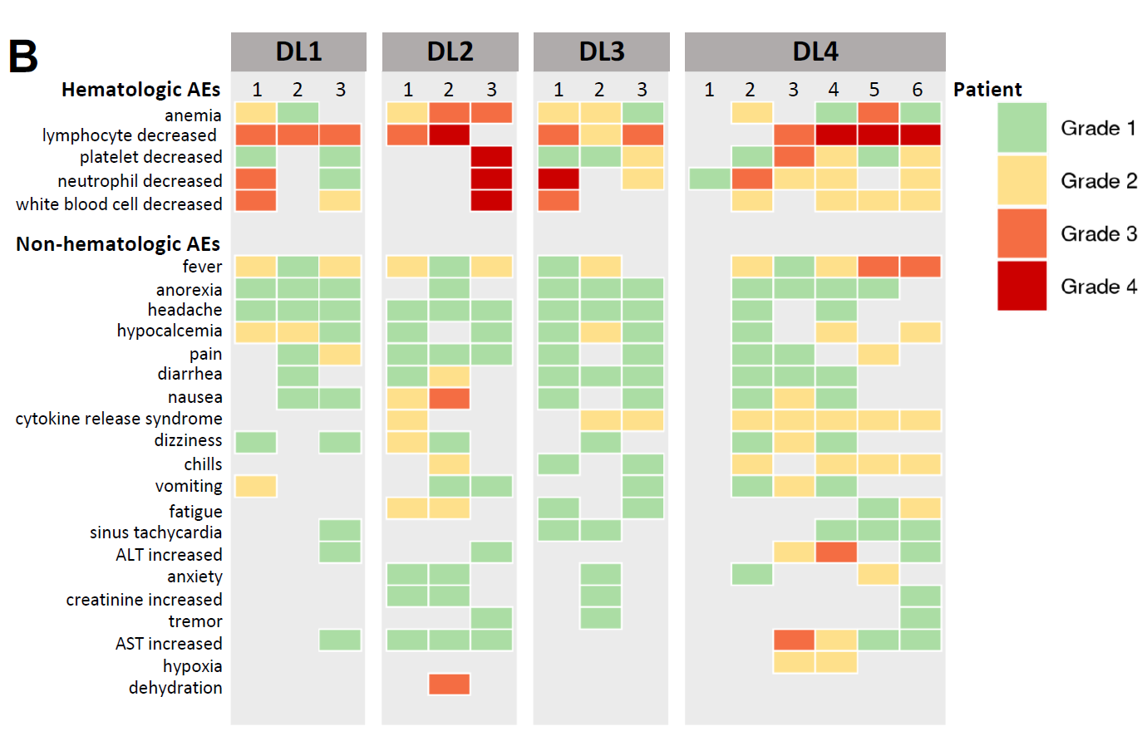
Safety
Notes:
We’ve used a heat map to display the AE’s

Slide 11
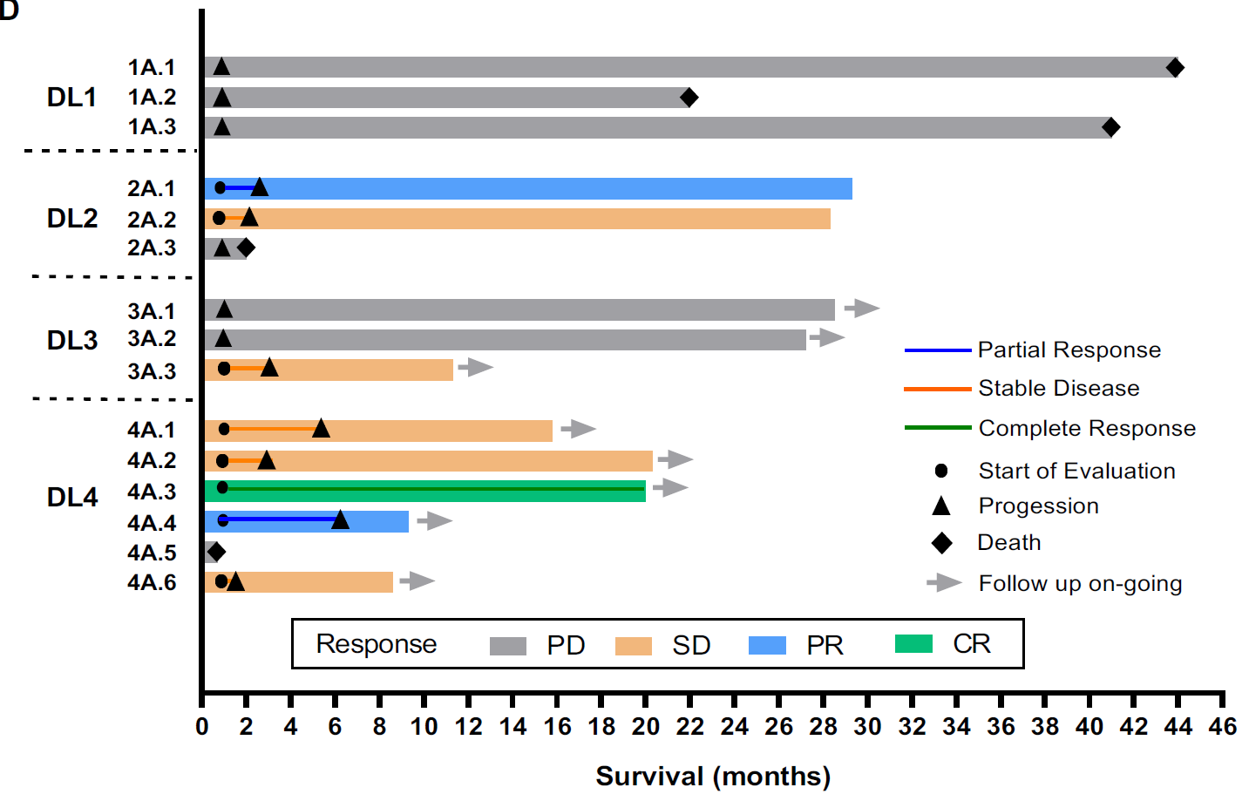
Clinical responses

Slide 12
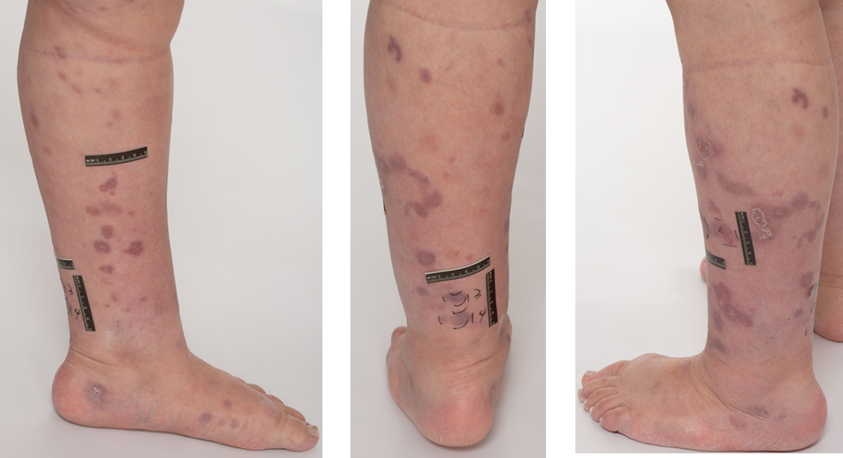
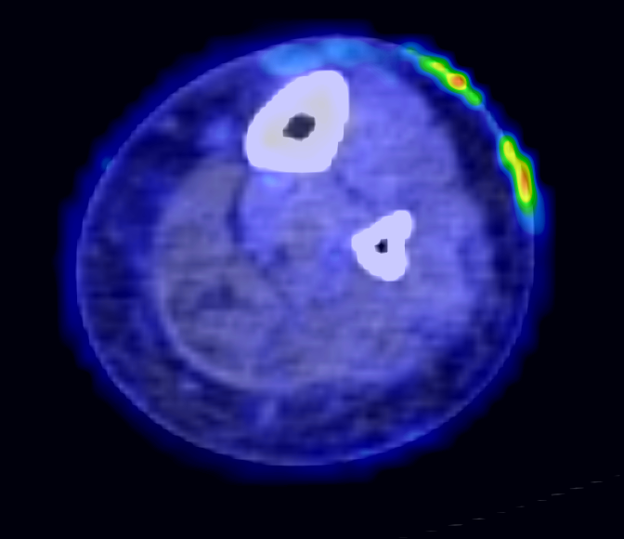
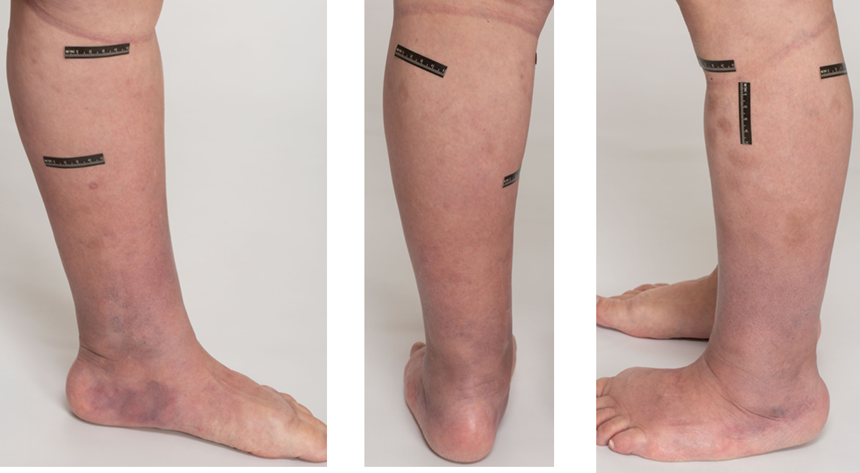
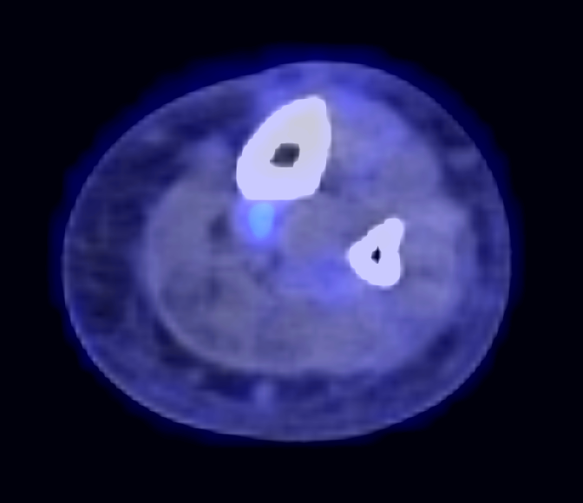
Ongoing 20-month Complete Response
Dose Level 4: 1.7x10¹¹ TCID₅₀
CD30+ Multi-site anaplastic
large cell TCL
Diagnosis in 2017
Prior treatments
Lenalidomide + CHOEP
Gemcitabine + Oxaliplatin
Cyclophosphamide
Nivolumab
Brentuximab Vendotin

Slide 13
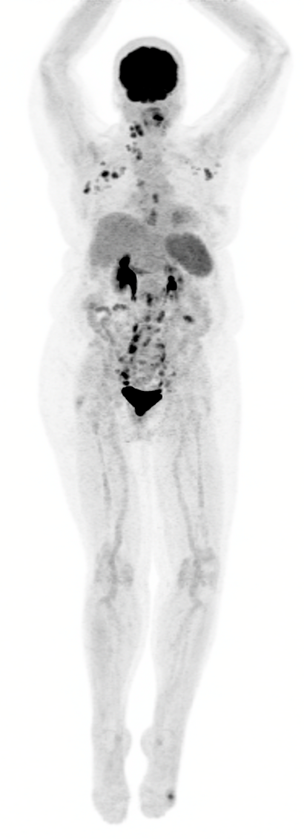
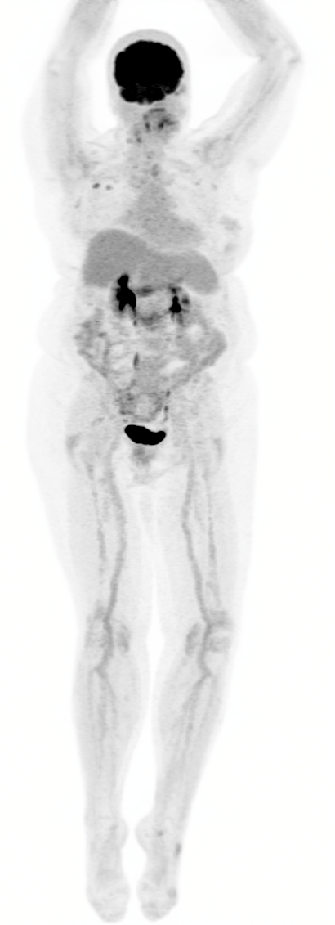
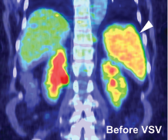
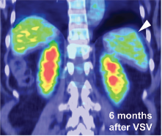
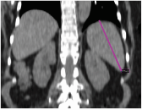
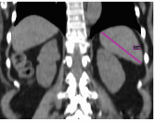
6-month Partial Response
Dose Level 4: 1.7x10¹¹ TCID₅₀
a.
b.
Before VSV
6 month after VSV
CD30+ Multi-site peripheral TCL
Diagnosis in 2013
Prior Treatments:
CHOP-Ritxuan
ICE
ASCT
Ruxolitinib
Romidepsin
Pralatrexate and pembrolizumab (clinical trial)
Before VSV
1 month after VSV

Slide 14
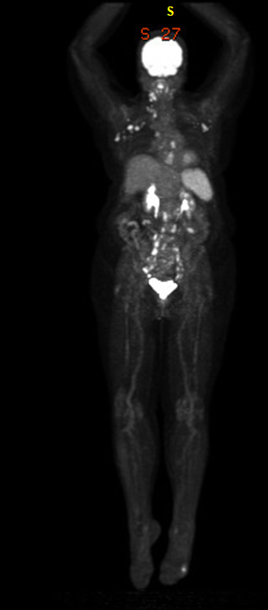
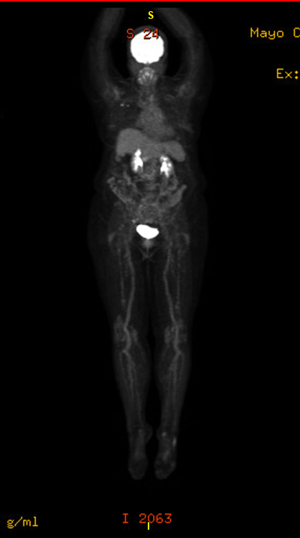
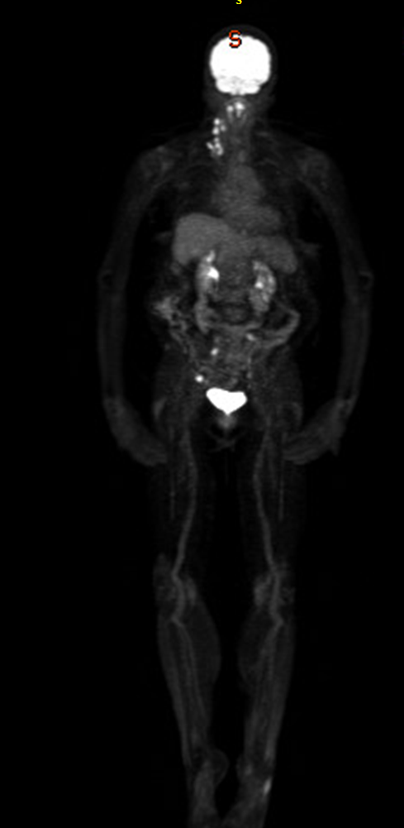
6-month Partial Response
Dose Level 4: 1.7x10¹¹ TCID₅₀
CD30+ Multi-site peripheral TCL
Diagnosis in 2013
Prior Treatments:
CHOP-Ritxuan
ICE
ASCT
Ruxolitinib
Romidepsin
Pralatrexate and pembrolizumab (clinical trial)
Notes:
To better contextualize the Pet response over time, this figure timeline
She ultimately relapsed in the cervical nodes but overall there is clearly deepning of response in other sites, including marked reduction in the size of the spleen.
( * Note- role of the spleen in VSV response and lymphomas)

Slide 15
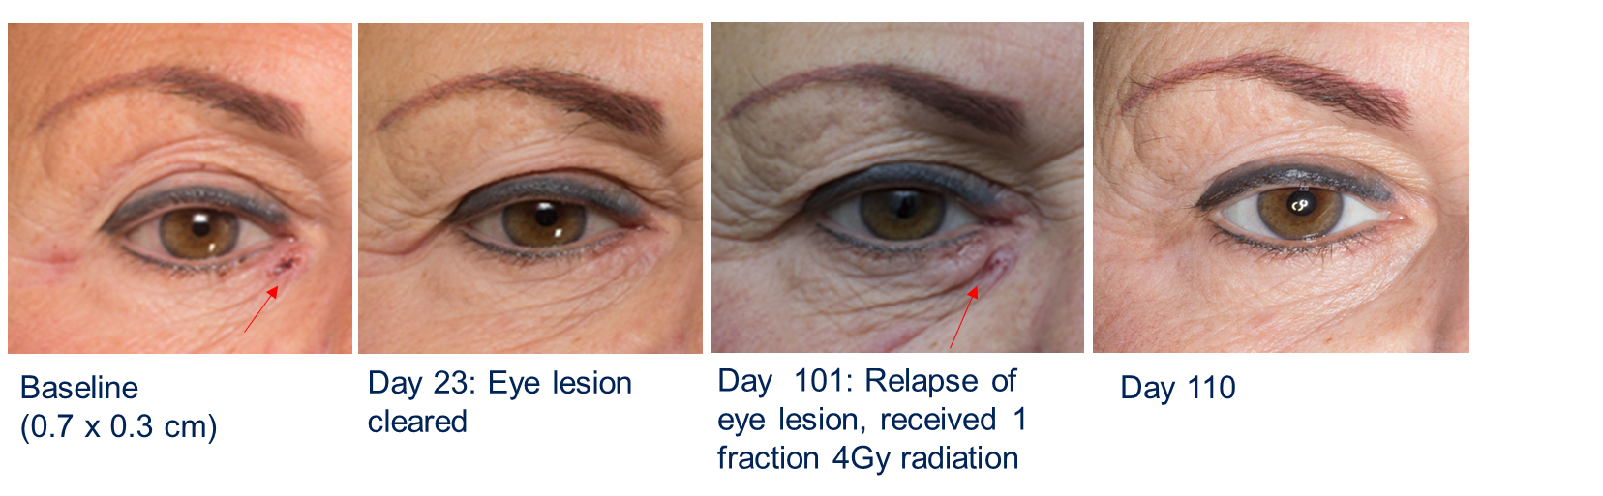
3-month Partial Response
Dose Level 2: 1.7 x 10¹⁰ TCID₅₀
CD30 positive CTCL
Diagnosis 2001
Prior treatments:
Interferon alpha
NCI protocol CPG7909
LS038B - tipifarnib
Gemcitabine x 3 cycles
LS0689 – Sorafenib and everolimus
MC0986 – Panobinostat
Gemzar and Medrol x 6 cycles
Bendamustine x 2 cycles
Romidepsin x 2 cycles
CA209039 - Nivolumab and Ipilimumab
Brentuximab x 13 cycles

Slide 16
Correlative analysis
Systemic administration of VSV-IFNβ-NIS among patients with Relapsed and Refractory Hematologic malignancies
Notes:
Hello. My name is Dr Joselle Cook, from the Mayo Clinic in Rochester.
It is such an honor for me to present the results of our work with VSV IFNb NIS in patients with relapsed refractory hematologic malignancies, highlighting the very promising results in the TCL cohort

Slide 17
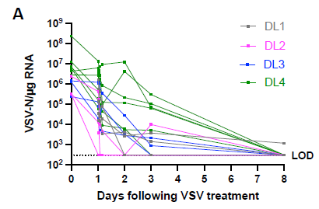
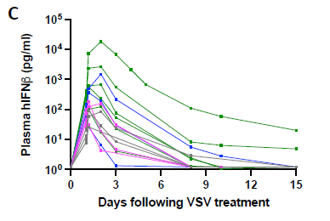
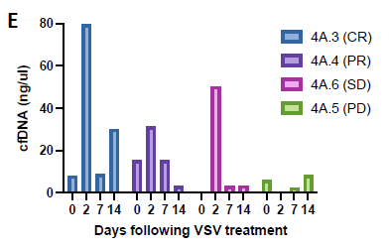

VSV-IFNβ-NIS Pharmacokinetics
Short-lived viremia
IFNβ peaks at 24-48 hours
cfDNA as an indicator of oncolysis
Notes:
1., We used Quantitative RT PCR was used to track the presence of VSV RNA in the blood and body fluids Viremia was very short lived and after peaking at the end of the infusion, we see here that the levels rapidly decline. There was no secondary viremia was detected.
2. Pharmacodynamics of VSV infection can be monitored by measuring the profile of virally encoded IFNβ in the plasma over time.
3. cell free DNA (cfDNA) in the plasma increased significantly from baseline in patients 4A.3 and 4A.6, who demonstrated robust viral replication as indicated by the high plasma IFNb at 18,213 and 2,650 pg/ml respectively (Fig. 4E). Patient 4A.5 with minimal viral infection, reflected in the very low (17 pg/ml) IFNb at 24h, showed no change in plasma cfNDA.

Slide 18
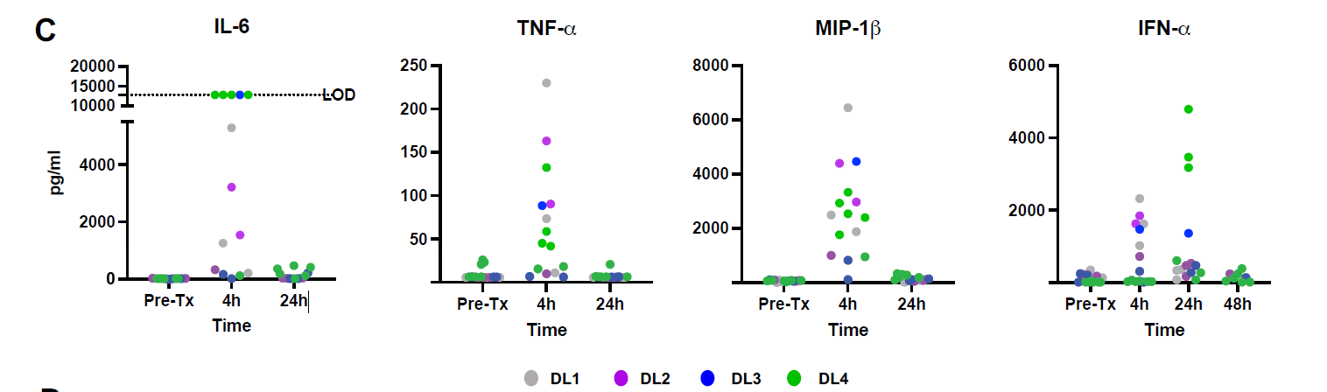
VSV-IFNβ-NIS Pharmacokinetics
Distinct pattern of IFNβ release compared to all other cytokines
Profile of IFNβ contrasts with all other cytokines
IL-6 is not persistently elevated
Notes:
While Interferon beta peaked at 24 hours before downtrending by 48 hours, multiplex cytokine assay showed that the other cytokines peaked at 4 hours while returning to baseline.
This is an important observation since we could interpret that this IFN release was virally encoded IFN and not just part of the inflammatory response, and also is a critical point when we come to discuss later management of the inflammatory response/cytokine release after viral therapy

Slide 19
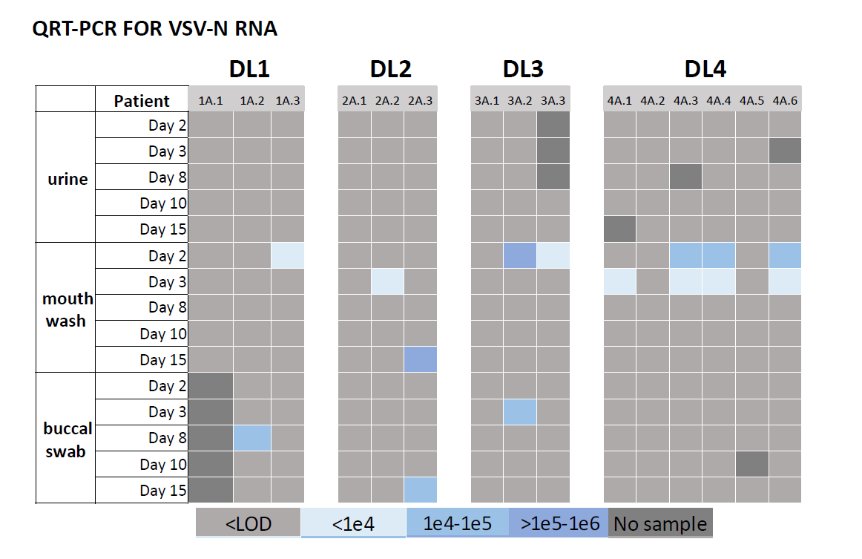
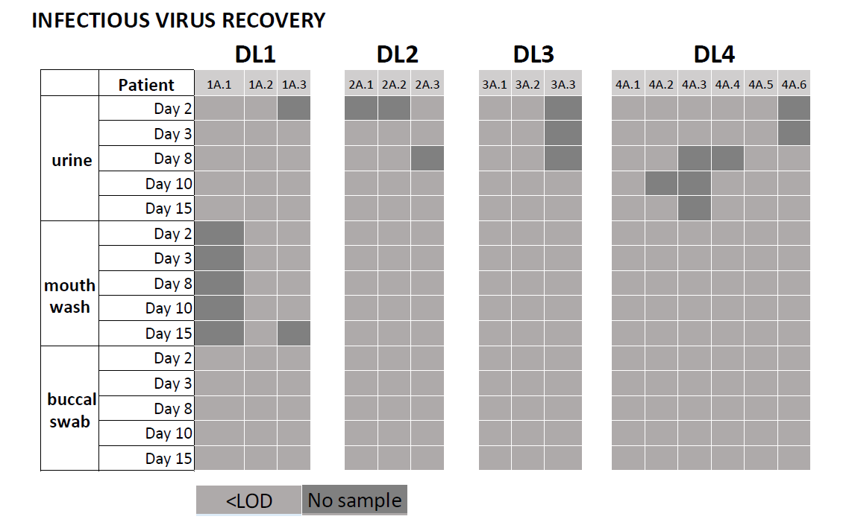
VSV-IFNβ-NIS Pharmacokinetics
No shedding of infectious virus
Notes:
We detected low levels of VSV-N RNA in the mouth rinse and buccal swab, but otherwise no significant virus shedding.
VSV-N RNA was below levels of detection in the majority of the timepoints analyzed, except for low levels at day 2 in the mouth rinse in some patients across dose levels
no infectious virus was isolated from any body fluids or buccal swabs at any time points from any patients, indicating no shedding of infectious virus

Slide 20
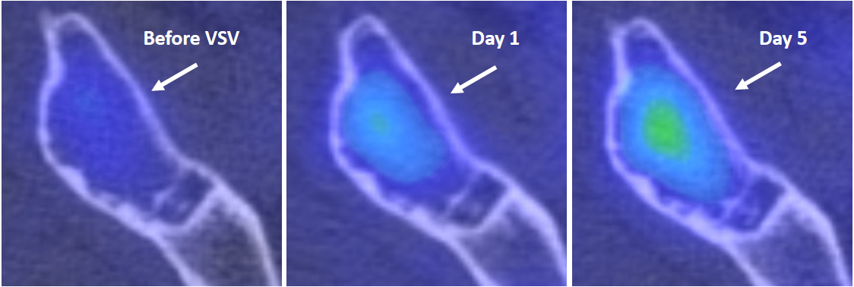
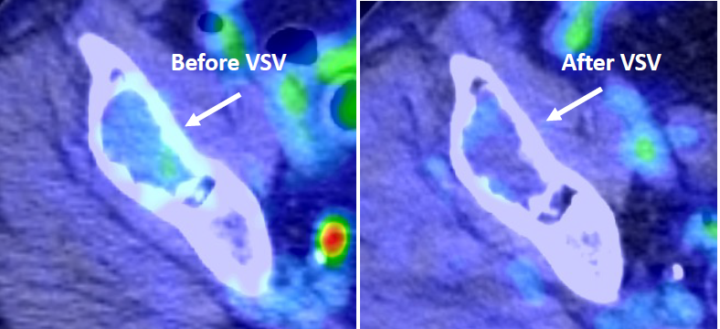
VSV-IFNβ-NIS Pharmacodynamics
NIS as a reporter gene
Positive NIS imaging of VSV infection in myeloma deposit
Corresponding activity on FDG PET/CT
Notes:
Here we show the utility of NIS transgene for noninvasive assessment of virus biodistribution in a patient with MM treated at dose level 3.
In the top panel, the axial fused 99m-Tc pertechnetate SPECT/CT images demonstrate increasing uptake within a lytic lesion in the anterior right ilium at baseline before VSV, Day 1 (24h), and Day 5 images (arrows). B,
This same lesion demonstrated decreased FDG activity when comparing pre- and post-therapy PET/CT images

Slide 21
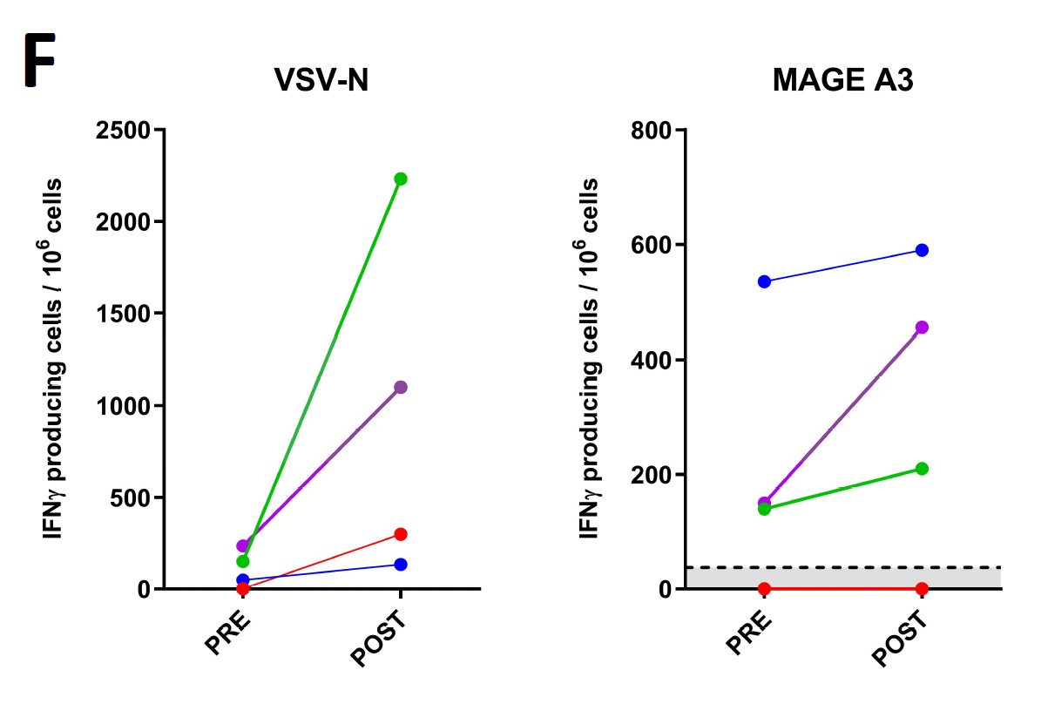
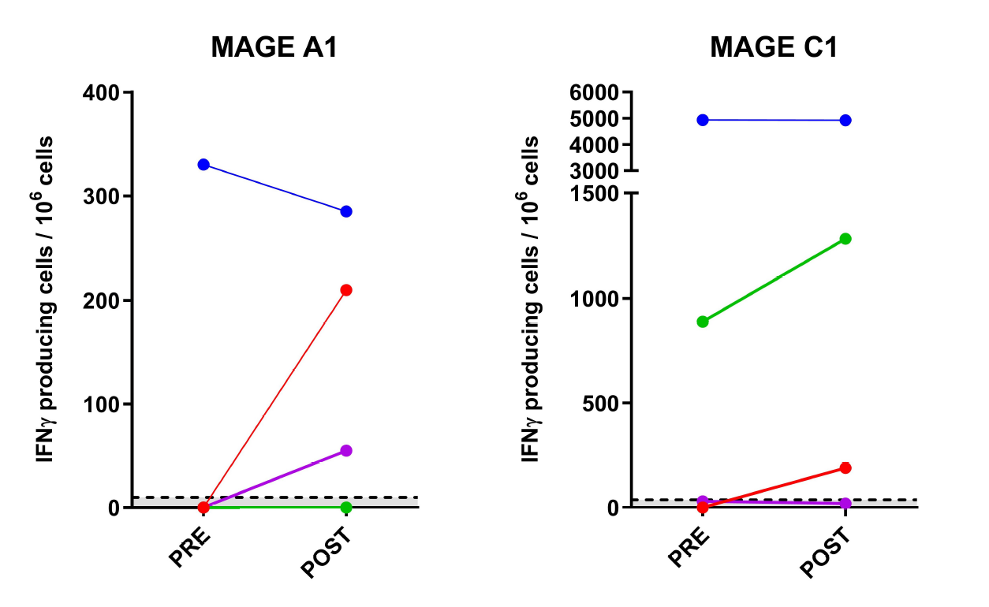
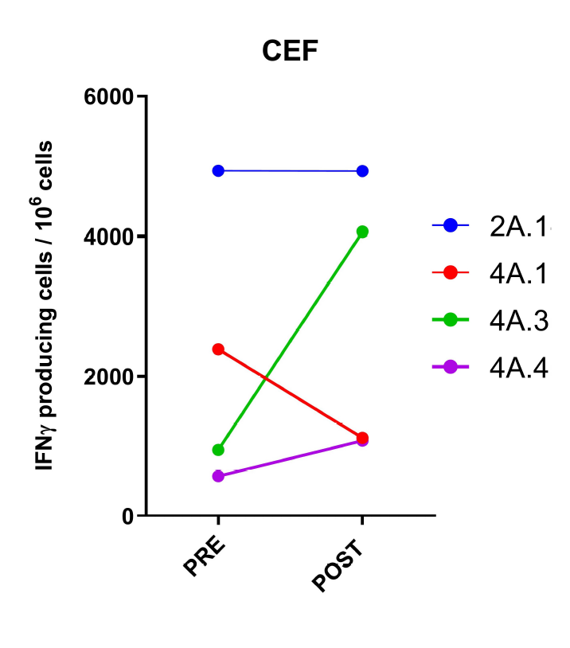
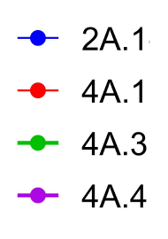
VSV-IFNβ-NIS increased T-cell responses to tumor antigen
TCL- 3-month PR
MM- non responder
TCL- ongoing 20-month CR
TCL- 6-month PR
Notes:
To investigate if VSV virotherapy might have increased immune responses to tumor antigens, PBMC from patients with clinical responses were incubated with peptide pools against a panel of tumor associated antigens (NYESO1, WT1, PRAME, MAGE A1, MAGE A3, MAGE C1, hTERT, Muc-1, p53), to VSV-N and CEF (Cytomegalo-, Epstein-Barr and Flu-virus) as positive control. T cell responses against VSV-N increased in all patients, most significantly in 4A.3 (CR) and 4A.4 (PR). Patient 2A.1 (PR) had strong baseline T cell responses against several tumor antigens; these did not increase further post VSV. Increases in tumor antigen reactive T cells were seen in patients 4A.3 and 4A.4 post VSV (Fig. 4F). In contrast, patient 4A.1 who did not have a clinical response, did not show boosting of tumor antigen reactive T cells.

Slide 22
Conclusions
Arm A: Single agent VSV
Systemic administration of VSV-IFNβ-NIS among patients with Relapsed and Refractory Hematologic malignancies
Notes:
Hello. My name is Dr Joselle Cook, from the Mayo Clinic in Rochester.
It is such an honor for me to present the results of our work with VSV IFNb NIS in patients with relapsed refractory hematologic malignancies, highlighting the very promising results in the TCL cohort

Slide 23
A single IV dose of VSV-IFNβ-NIS up to 1.7 x 10¹¹ TCID50
is safe in pts with R/R hematologic malignancies
    No dose limiting toxicities, AE’s predominantly hematologic; no CRS> grade 2
Patients with R/R T-Cell Lymphoma demonstrate efficacy signal to
single agent VSV-IFNβ-NIS
    Overall, heavily pretreated, refractory cohort
    50% response in TCL at dose level 4
    Responses seen with a single one-time dose
Insertion of transgenes useful for noninvasive assessment
    IFNβ is an early biomarker of intratumoral virus amplification
    NIS Imaging demonstrates site of intratumoral viral spread
Notes:
Hello. My name is Dr Joselle Cook, from the Mayo Clinic in Rochester.
It is such an honor for me to present the results of our work with VSV IFNb NIS in patients with relapsed refractory hematologic malignancies, highlighting the very promising results in the TCL cohort

Slide 24
VSV-IFNβ-NIS
+Ruxolitinib
+Ruxolitinib and Cyclophosphamide
IOVC 2021
Notes:
Hello. My name is Dr Joselle Cook, from the Mayo Clinic in Rochester.
It is such an honor for me to present the results of our work with VSV IFNb NIS in patients with relapsed refractory hematologic malignancies, highlighting the very promising results in the TCL cohort

Slide 25
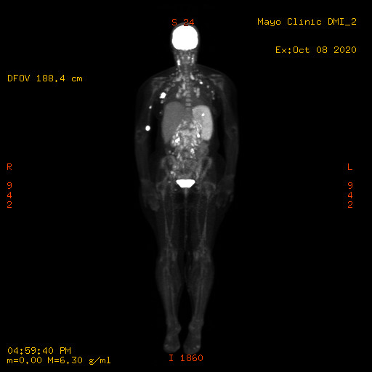
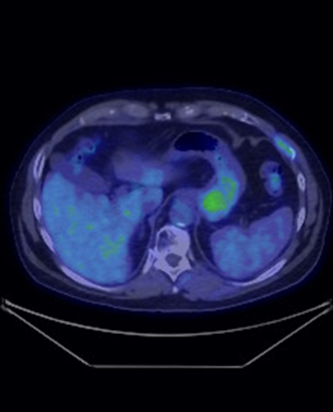
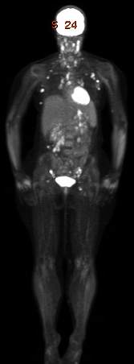
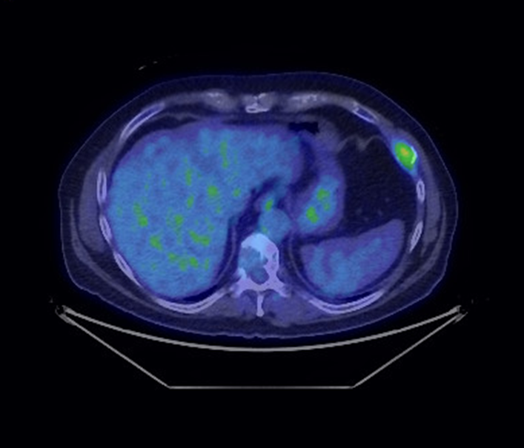
Responses with VSV-IFNβ-NIS +Ruxolitinib
Dose Level 2: VSVIFNβ-NIS + Ruxolitinib
Peripheral T cell lymphoma
Mixed response
Dose Level 3: VSVIFNβ-NIS + Ruxolitinib
Multiple Myeloma
Mixed response

Slide 26
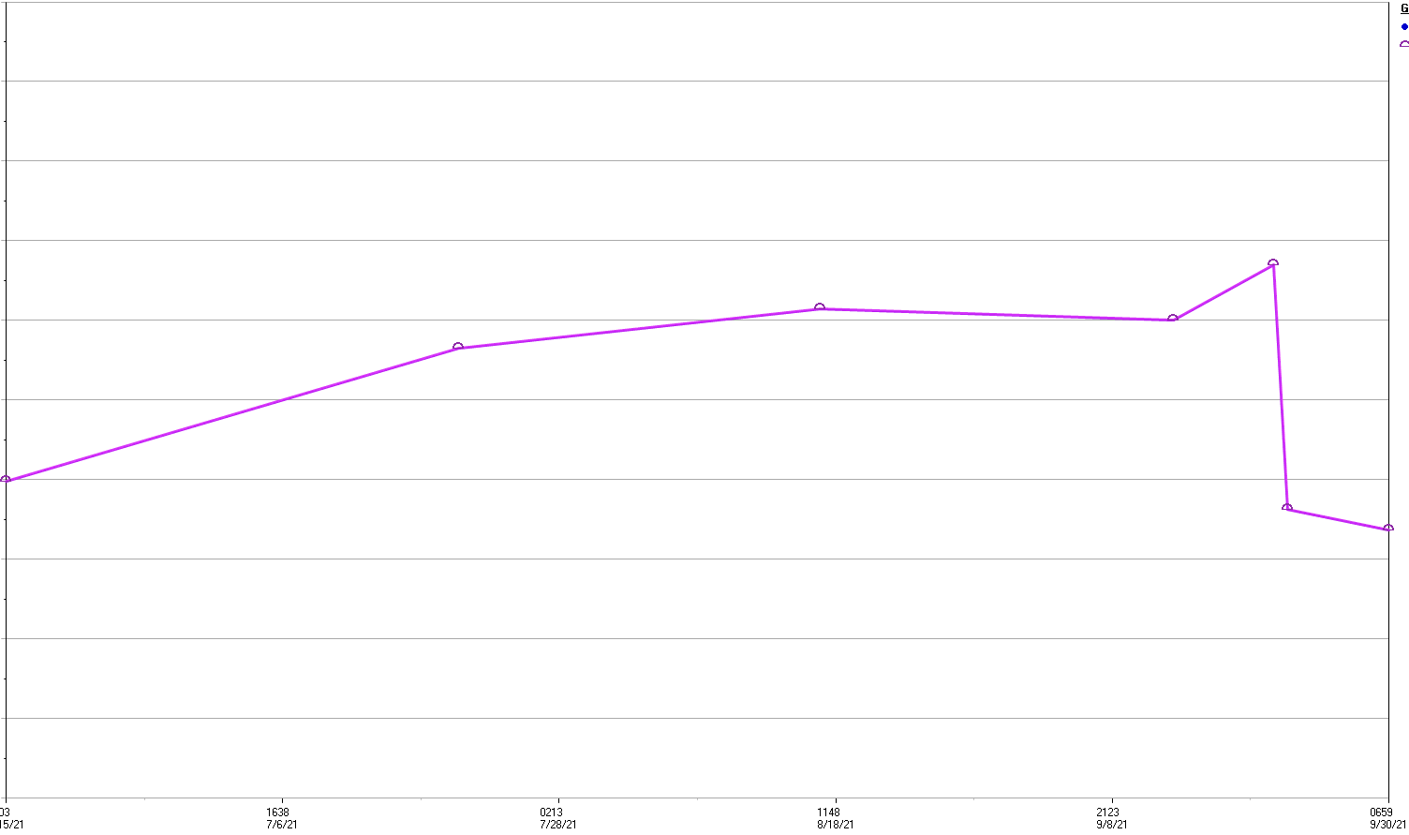
Responses with VSV-IFNβ-NIS +Ruxolitinib
Dose Level 3: VSVIFNβ-NIS + Ruxolitinib
Multiple myeloma
Trend of Kappa Light chain
Pre VSV
Kappa 13.3mg/dl
Day 10 VSV
Kappa
6.73 mg/dl

Slide 27
What we've learned ...
IOVC 2021
Notes:
Pt selection
Dose
TFB pet
Viral idcued cytokine release is a distinct entity

Slide 28
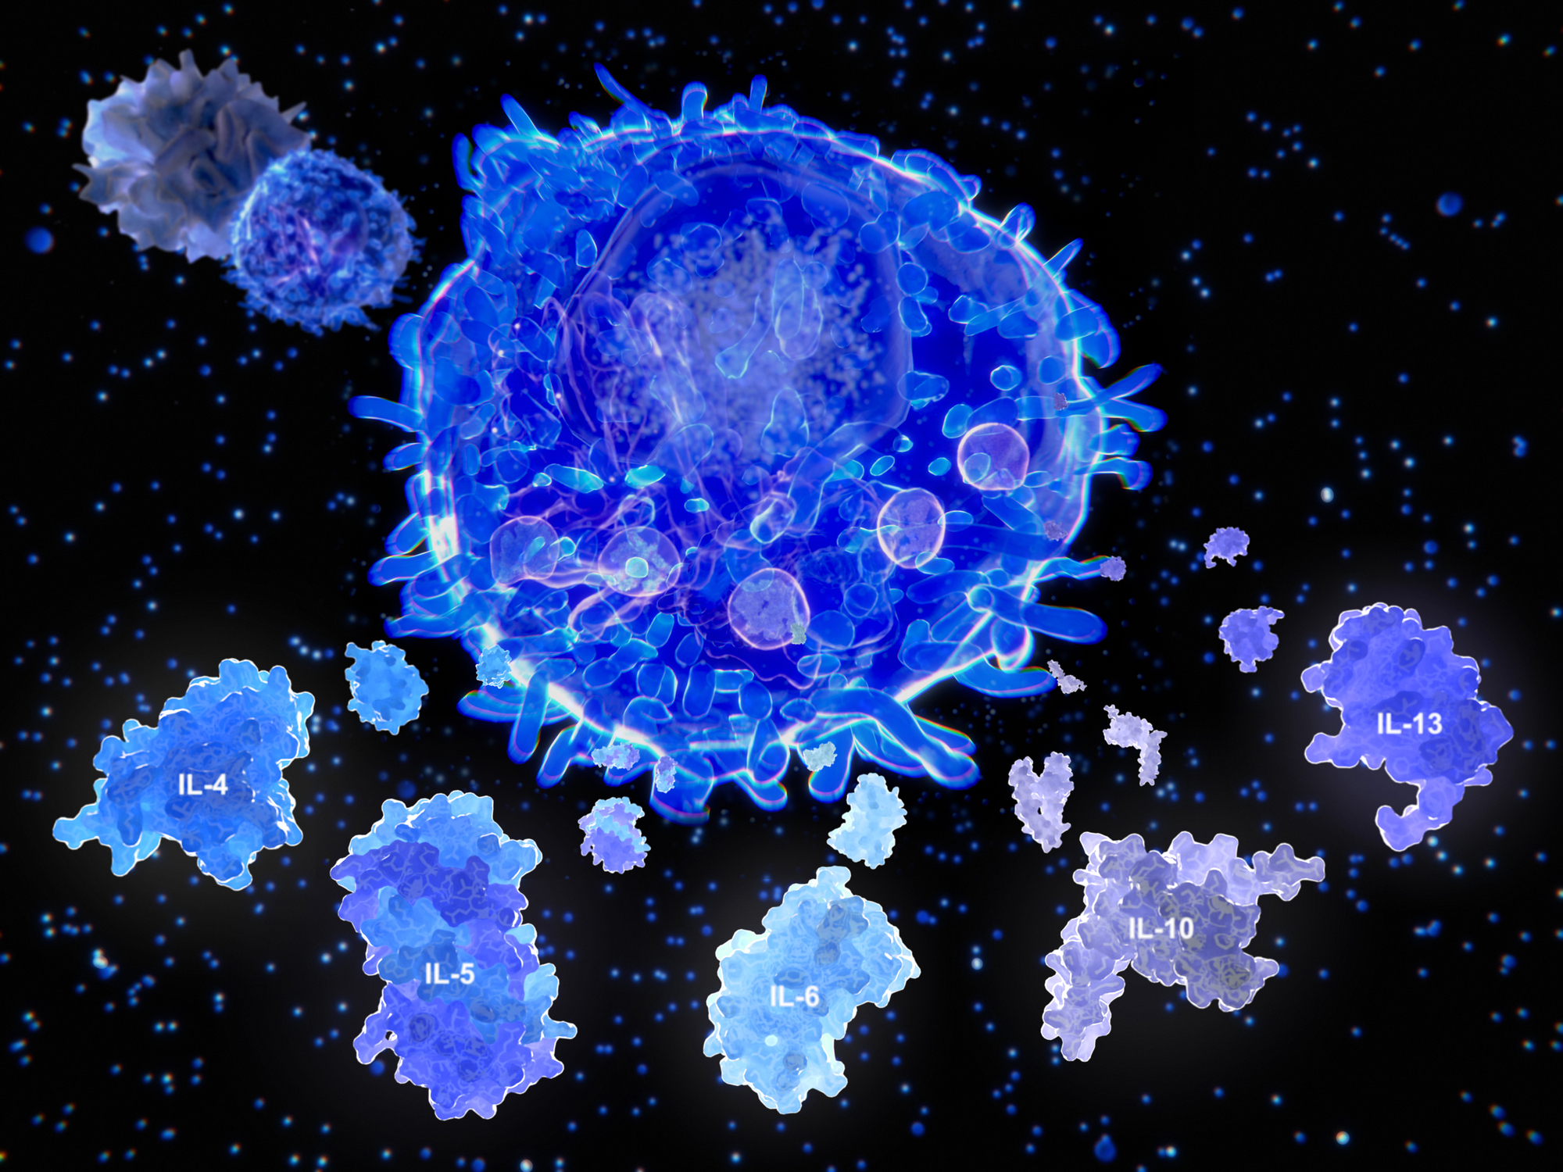
#1
VSV-Induced Cytokine Syndrome is unique
VSV administration is associated with Distinct Syndrome
  Early phase: CRS with cytopenias
  Mid phase: IFN beta toxicity
  +/-Late phase: TLS
Not to be confused with CRS related to CAR-T therapy
  IL6 is not persistently elevated
Ruxolitinib not tocilizumab indicated in management
Notes:
Now that we’ve had quite a bt of experience with VSV not only with Heme malignancies but with other tumor types, we know that OVCR is not CRS.
The

Slide 29
VSV-induced cytokine syndrome
VICS?
Early
CRS
(90%)
Mid Phase
Interferon beta toxicity (2% cases)
Late Phase
Tumor Lysis Syndrome (2% cases)
D1 | D2 | D3 | D4 | D5 | D6 | D7 | D8 | D9 | D10 | D11 | D12
Syndrome | 1. CRS with cytopenias | 2. IFNβ toxicity | 3. Tumor lysis
Timing | Early, onset 4-8 hours | Intermediate, onset 24-120 hours | Late, onset after 96 hours
Trigger | Virus infusion | High levels of IFNβ released from numerous virus infected tumor cells | Synchronous death of numerous virus infected tumor cells
Pathogenesis | Innate immune activation, cytokine release (IL6 peaks early, returns to baseline by 24 hrs) | Hepatic sinusoidal endothelial damage, intrasinusoidal platelet clumping | Release of K⁺, PO4⁻, nucleic acids causing arrhythmias, urate nephrophathy
Frequency | ~90% | ~2% | ~2%
Features | Fever, malaise, hypotension, hypoxia, AST ↑, PLT ↓, lymphopenia | Malaise, hypotension, confusion, AST↑↑, PLT ↓↓, liver failure | K+ ↑, PO₄⁻ ↑, Ca ↓, LDH↑, urate↑, arrhythmias, renal failure
Management | Prophylaxis, fluids, Pressors, O₂ if needed | Ruxolitinib (Jakafi™) 15 mg BID, 7 days – blocks IFNβ signaling, supportive care, fluids, inform Vyriad for expedited correlatives | Rasburicase, fluids, correct hyperkalemia, renal dialysis if needed, inform Vyriad for expedited correlatives
Resolution | Rapid resolution expected (by 24-36 hours) | Resolution expected. Monitor closely, escalate Ruxolitinib if needed (per algorithm), give maximal supportive care. Liver damage is reversible. | Resolution expected
29
Notes:
potential toxicities of VSV IFNbNIS in3 phases
1. Early CRS resolving in 24 to 48 hours, and occurring in the majority of patients.
2. But in a few patients we need to be keen to the possibility of interferon beta toxicity especially in those with highly susceptible tumors between days 2-5 after virus administration
3. With rapid viral amplification and usually oncolytic effect, this can be followed by TLS.
We’ve created a protocol to ensure unfirom care at all sites with a mitigation strategy to include allopurinol, with early signs of IFNb tox, and Ruxolitinib
Option to use Ruxo even at day 3 with clinical suspicion
Keep vigilant, recognize IFN tox, Give ruxo, Manage TLS. This is reversible

Slide 30
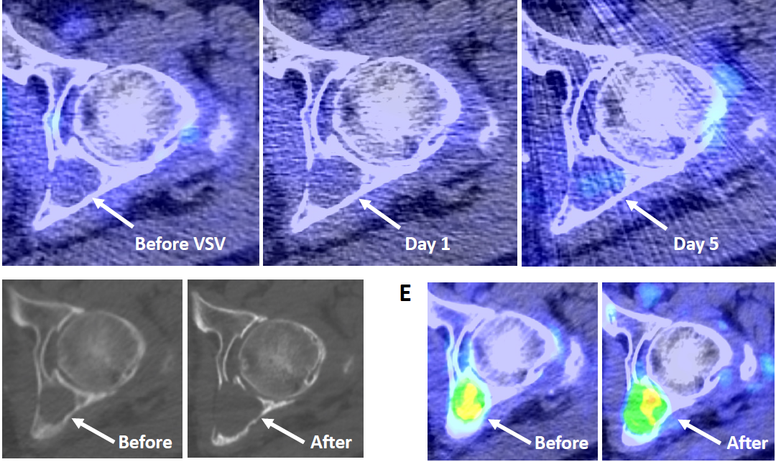
#2
TFB PET for future NIS imaging
^{99m}Tc Pertechnetate SPECT/CT
-provided clear images of virus infection in only one patient
-lower sensitivity and spatial resolution
^{18F}TFB PET
  Higher sensitivity, 10x more than SEPCT
  cleaner, sharper images
  High yield emission
  Minimal background signal
  low absorbed radiation dose
Notes:
VSV-IFNβ-NIS was designed to facilitate the noninvasive in vivo tracking of intratumoral virus replication in treated patients, either by NIS reporter gene imaging using monovalent radioiodine, pertechnetate or tetrafluoroborate anions¹⁹, or by serial determination of plasma levels of virally-encoded IFNβ. However, in this study, with exception of one patient who had multiple plasmacytomas, ^{99m}Tc pertechnetate SPECT/CT did not provide clear images of virus infection, even among the responding patients. This may have been due to the low sensitivity and spatial resolution of ^{99m}Tc-pertechnetate SPECT imaging. Therefore, we are transitioning to NIS reporter imaging with ¹⁸F tetrafluoroborate PET in our amended protocol^{33,34}.
, In contrast, a left acetabular lesion in the same patient demonstrated no increased uptake on SPECT/CT at baseline, day 1, or day 5 scans suggesting minimal VSV infection (arrows). The 6-month follow up (D) CT and (E) fused PET/CT images showed progression of the acetabular lesion, with increased size, bone destruction, and FDG uptake (arrows).

Slide 31
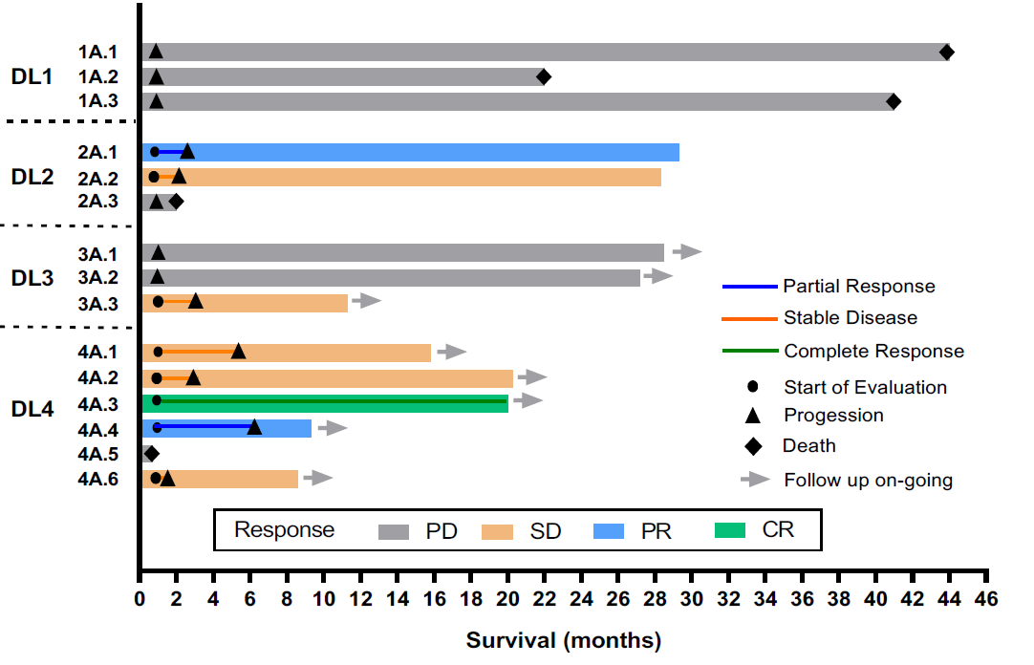
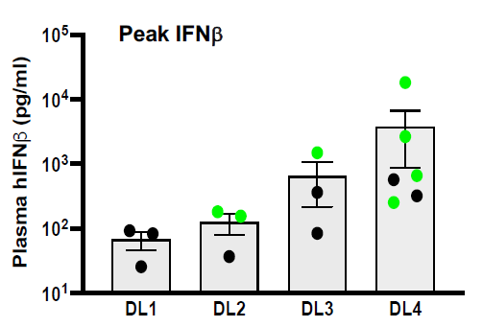
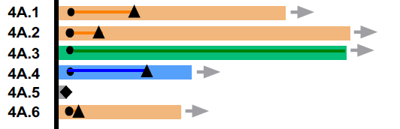
#3
Higher Dose is key in achieving clinical responses
Notes:
And we are seeing that even in Arm B where we’ve achieved our first PR with MM

Slide 32
#4
Patient selection
With bulky tumors, ↑intratumoral pressures and ↑stromal resistance may impede viral delivery
TCL-Progressive disease
Dose level 4
IFNβ at 24h: 17 pg/ml
Notes:
FDG PET-CT scan of patient 4A.5 prior to VSV therapy, with CD30 positive myco
Patient 4A.5 with minimal viral infection, reflected in the very low (17 pg/ml) IFNb at 24h, showed no change in plasma cfNDAsis fungoides showing extensive, bulky, lymphomatous skin lesions which were highly glucose avid.

Slide 33
What’s next for
VSV-IFNβ-NIS …
IOVC 2021
Notes:
Pt selection
Dose
TFB pet
Viral idcued cytokine release is a distinct entity

Slide 34
Currently recruiting…
DOSE EXPANSION- SINGLE AGENT VSV
8 T-Cell lymphoma patients at 1.7x10¹¹ TCID₅₀
ARM B: VSV-IFNΒ-NIS WITH RUXOLITINIB
ARM C: VSV-IFNΒ-NIS WITH RUXOLITINIB & CYCLOPHOSPHAMIDE
_{Dose Level 3 completed}
_{Recruiting at Dose Level 2}
DL4:
1.7e11 TCID₅₀
N=6
8 patient expansion for TCL patients DL4: 1.7e11 TCID₅₀
DL4:
1.7e11 TCID₅₀
DL4:
1.7e11 TCID₅₀
DL3:
5e10 TCID₅₀
N=3
DL3:
5e10 TCID₅₀
N=3
DL3:
5e10 TCID₅₀
N=3
DL2:
1.7e10 TCID₅₀
N=3
DL2:
1.7e10 TCID₅₀
N=3
DL2:
1.7e10 TCID₅₀
N=3
DL1:
5e9 TCID₅₀
N=3
DL1:
5e9 TCID₅₀
N=3
DL1:
5e9 TCID₅₀
N=3
Notes:
Lots in the pipleline for systemic VSV

Slide 35
Acknowledgements
Principle Investigators
Dr. Martha Q. Lacy
Dr. Stephen J. Russell
Dr. Kah Whye Peng
Division of Hematology
Russell and Peng Lab
Nandakumar Packiriswamy
Lianwen Zhang
Baskar Balakrishnan
Beth Brunton
Mike Steele
Alysha Newsom
Nathan Jenks
Our Patients
Thomas E Witzig
Nora Bennani
Mrinal S Patnaik
Francis K Buadi
Angela Dispenzieri
Morie A Gertz
Rahma Warsame
Ronald S Go
Suzanne R Hayman
David Dingli
S Vincent Rajkumar
Nelson Leung
Leif Bergsagel
Javier Munoz
Wilson Gonsalves Taxiarchis Kourelis
Eli Muchtar
Moritz Binder
Prashant Kapoor
Robert A Kyle
Yi Lin
Amie Fonder
Miriam Hobbs
Lisa Hwa
Shaji K Kumar
Statisticians and Clinical trial support
Susan Geyer Amylou C . Dueck, Brenda F. Ginos, Marissa Giers
Ann Birgin
Radiology
Stephen M Broski
IOVC 2021
Notes:
Principle investigators who pioneered this study and have mentored me over the past couple years

Slide 36

Thank You
Questions and discussion
@JoselleCookMD

